Slide 1

Planning for the Integration of Ride-Hailing Services with Transit
V. D. Pyrialakou¹, P. Hajibabaee², L. Farrokhvar³, A. Williams¹​
1: West Virginia University, 2: University of Massachusetts Lowell, 3: California State University Northridge
The Case of
Small Transit Agencies
Aigars Reinholds/Shutterstock.com

Slide 2
INTRODUCTION
Public-private partnerships between transit agencies and transportation network companies (TNCs).
Early planning stages of establishing a ride-hailing program within a small transit agency.
Exploring the perceived and actual potential benefits/costs and performance of different ride-hailing service models.
Proposing a framework based on selected multi-criteria decision analysis (MCDA) methods.
Notes:
To address the lack of specific guidance and resources that can be used by small transit agencies, this paper focuses on the early planning stages of establishing a ride-hailing program within rural and small urban transit agencies. According to the Partnership Playbook developed as part of the TCRP Research Report 204¹, the first step towards developing a TNC partnership (i.e., “Organize and Plan”) involves the definition of the problem or service gap and the identification of the intent of the partnership.
To address the lack of specific guidance are resources that can be used by small transit agencies, we focus on the early planning stages of establishing a ride-hailing program within a small transit agency. We, specifically
Establish a framework based on multi-criteria decision analysis (MCDA) methods that can be used to assess the perceived and actual potential benefits and performance of different ride-hailing service models.
Illustrate the framework using the case study of Mountain Line Transit Authority (MLTA), operating in Monongalia County, WV.
Explore and compare the ranking of specified ride-hailing service models, using as an input the stakeholders' perceived performance of the models.
Explore the differences between perceived and actual potential benefits and performance of the models.
National Academies of Sciences, E. Partnerships Between Transit Agencies and Transportation Network Companies. 2019.

Slide 3
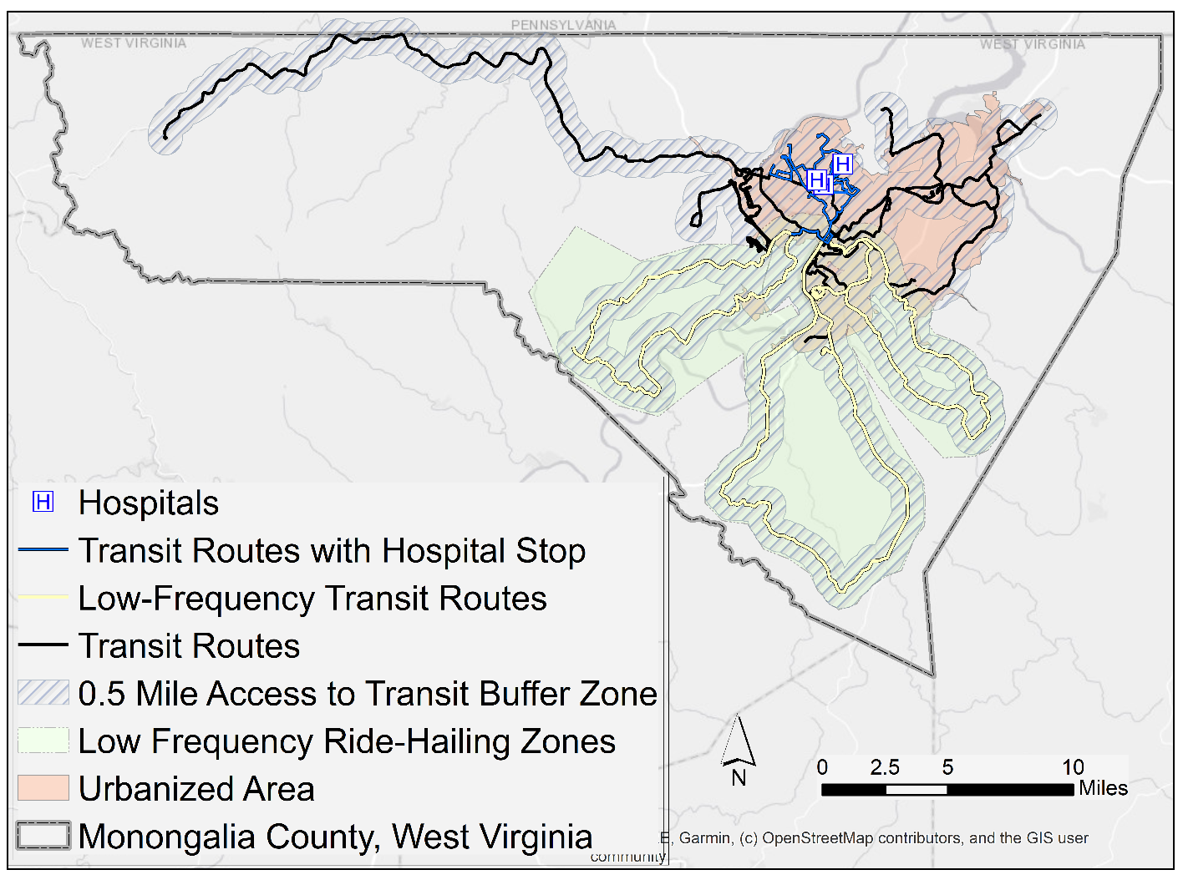
EMPIRICAL SETTING
Mountain Line Transit Authority (MLTA)
Founded in 1996
The primary transit provider in
Morgantown (campus town of West Virginia University)
Monongalia County, WV (pop. of over 106,000 people)
Primarily fixed-deviated routes
Notes:
Although Monongalia County is classified as a Metropolitan statistical area according to the Office of Management and Budget classification, it is predominantly a rural county. According to the Census Urban-Rural Classification of 2010, approximately 89% of the area is rural (327 mi²), while only 11% (39mi²) is classified as Urbanized Area. MLTA is considered a small urban agency and is classified as a reduced reporter for the National Transit Database (NTD) reporting purposes.
For all non-express routes, access and egress are allowed anywhere throughout a bus route, as long as the infrastructure and safety practices allow it. Because of this “flag down” system and due to the topography and tight street environment, there is limited conventional transit infrastructure in place (i.e., bus shelters and bus stop signs are not predominant).

Slide 4
METHODOLOGY AND RESEARCH BACKGROUND
Multi Criteria Decision Analysis
is used to address the complexity of transit agency decisions associating with evaluating and selecting a ride-hailing program for integration.
is to help policymakers select the preferable choice among several possible alternatives, accounting for a wide range of criteria.
allows the integration of quantitative and qualitative information/input into a single assessment/output.
Notes:
The majority of decision problems in the public sector have a complex character and involve many possible alternatives, uncertainties, and many stakeholders with various interests¹.
Walker, W. E. Policy Analysis: A Systematic Approach to Supporting Policymaking in the Public Sector. Journal of Multi‐Criteria Decision Analysis, Vol. 9, No. 1‐3, 2000, pp. 11–27.

Slide 5
Alternatives
Five alternatives, including the base scenario (or business as usual) and four alternatives.
A0 – Do nothing
A1 – First/Last-mile
A2 – Late night/Early morning
A3 – On-Demand (substitution of low-frequency fixed routes)
A4 – On-Demand (non-coverage)
Notes:
When defining each criterion, the main question should be: how would you like to measure success/progress towards the goal? Criteria can be categorized as beneficial, i.e., the higher value, the better result, and non-beneficial, i.e., the lower value leads to a better result.
MLTA alternatives considered:
A0-Do nothing: This was the base scenario or a representation of the current or as-is situation. The reader is referred to the section Empirical Setting that discusses the current services provided by MLTA.
A1–First/Last-mile: This was described as providing first/last-mile connections to and from different locations where a passenger can transfer to a fixed-route (i.e., transit centers, bus stops, or intersections with transit service) throughout Monongalia County for areas that are not sufficiently served by pedestrian connections.
A2 - Late night/Early morning: This program was described as overnight door-to-door rides throughout Monongalia County (e.g., 10 pm to 6 am). MLTA currently provides two late-night fixed-route services. The stakeholders felt that this service type could substitute these current services and expand to other service areas; they envisioned the program as open to the general public.
A3 - On-Demand (substitution of low-frequency fixed routes): This program was described as substituting low-frequency fixed-route services with on-demand service for the general public in areas previously serviced by the fixed route. This service model is typically offered in designated service areas (or zones) in which the ride-hailing program operates. The MLTA stakeholders identified three specific routes that are considering substituting with a ride-hailing service. From the discussions, it was evident that eliminating these low-performing (low-frequency, low-demand) services was a strong motivator for the stakeholders. The three routes, shown in Figure of slide #3, are offered two or three times per day during peak-hours (i.e., headway between more than one and five hours).
A4 - On-Demand (non-coverage): This program was described as providing on-demand service for the general public in areas of Monongalia County where there is no access to fixed routes. Typically, this service model is offered for trips that start or end outside of the fixed-route service areas.

Slide 6
Criteria
The factors that are used to evaluate a set of alternatives are called criteria.
C_{j} | Final Criteria Used
C₁ | Other operating expenses
C₂ | Cost of ride-hailing program
C₃ | System-wide ridership (including the riders of ride-hailing program)
C₄ | Geographic coverage (i.e., service area)
C₅ | Accessibility (i.e., population with access to public transit services)
C₆ | First/last mile services
C₇ | Access to health services
C₈ | Service hours
C₉ | Passengers’ waiting time
C₁₀ | Customer satisfaction
C₁₁ | Providing peak-hour mobility services
C₁₂ | Providing off peak-hour mobility services
C₁₃ | Providing mobility options in suburban/rural areas
C₁₄ | Demographic makeup of participants
C₁₅ | Impact on traffic congestion and/or parking demand
Notes:
The weight of each criterion expresses the perceived relative importance of the criterion. In this study, we identified a list of initial criteria based on the literature. The list was shared with the MLTA participants, and the selected the shown 15 criteria as pertinent.

Slide 7
Attributes
Based on the identified criteria, the attributes of these criteria can be identified.
There are different ways to measure an attribute, depending on the decision-makers’ goal.
When defining each criterion, the main question should be: how would you like to measure success/progress towards the goal?
Criteria can be categorized as beneficial, i.e., the higher value, the better result, and non-beneficial, i.e., the lower value leads to a better result.
Notes:
There are different ways to measure an attribute, depending on the decision-makers’ goal. When defining each criterion, the main question should be: how would you like to measure success/progress towards the goal? Criteria can be categorized as beneficial, i.e., the higher value, the better result, and non-beneficial, i.e., the lower value leads to a better result

Slide 8



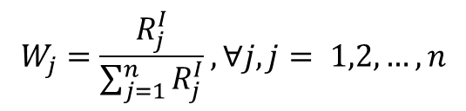
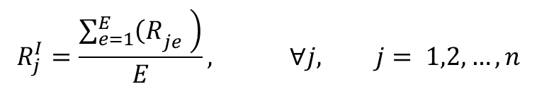

Weighting of Criteria
The weights of each criterion represent the importance of the various evaluation criteria.
Decision-makers assign a relative weight to every criterion.
The weight represents the perceived relative importance of the criterion.
The general formulation of criteria weighting:
$$R_{j}^{I}=\frac{\left.\sum_{e=1}^{E}{{\left(R\right.}_{je}} \right)}{E}, ∀j, j= 1,2,…,n$$
(1)
$$W_{j}=\frac{R_{j}^{I}}{\sum_{j=1}^{n}{R_{j}^{I}}}, ∀j, j= 1,2,…,n$$
$$with \sum_{j=1}^{n}{{\left(W\right.}_{j}} ) =1$$
(2)
(3)
Notes:
Let j denote the criterion index , j = 1, …, n. When a group of E experts are asked to rate each criterion, , where e is the index of the expert, e = 1, …, E.
The rates allocated by each expert e to each criterion j, are averaged (as shown in Eq. 1) to estimate the rate of each criterion j. Each expert rates each criterion using a scale (in this study, we used the following scale, 1: not at all important to 5: extremely important). Then the weight for each criterion j, will be calculated, as shown in Eq. 2. The final weights should be nonnegative values that sum to 1, as reflected in Eq. 3.

Slide 9
MCDA Methods
 | Strength | Calculation Procedure | Scaling
Weighted Sum Method (WSM) | Simple and easy to handle problems in decision making with multiple criteria. | Easy | Max Scaling
Technique for the Order of Preference by Similarity to the Ideal Solution (TOPSIS) | Accounts for both the ideal-best and ideal-worst solutions. | Medium | Vector Scaling
VIšekriterijumsko KOmpromisno Rangiranje (VIKOR) | Maximize group benefits and minimize individual regret so that decision-makers can consider consensus solutions more easily. | Medium | Linear Normalization
Notes:
The main goal of MCDA methods is to identify a ranking of alternatives from most to least preferable, given a set of relevant decision criteria and alternatives. Three different MCDA methods were explored in this study: WSM, TOPSIS, and VIKOR.

Slide 10
Measured Benefits and Costs
This study incorporates four measures of potential spatial-related benefits.
The results between initial MCDA findings and the findings of the enhanced with the objective measures were compared.
The data sources included GTFS data and data from the American Community Survey.
Zones were used to calculate the performance of the ride-hailing services.
The same calculation process was repeated for each of the five alternatives.
Notes:
This study incorporates four measures of potential spatial-related benefits in the MCDA analysis.
GTFS data provided by MLTA and 2018 5-year American Community Survey (ACS) data at the block-group level were used to estimate population sizes. Finally, we used the 2017 Tiger Line U.S. Urban Area/Urban shapefile to determine the urban area. The spatial analysis was done using ArcGIS Pro.

Slide 11
Measured Benefits and Costs
Geographic Coverage
Captures the coverage of the MLTA fixed-routes and potential ride-hailing services (in mi²).
The ArcGIS Pro “Summarize Within” function was used to calculate the area MLTA’s fixed routes cover within the county.
Accessibility
A population-based measure that measures the percentage of the population in the county that has access to the transit services was used.
Notes:
A 0.5-mile buffer surrounding the routes was considered, following common research practices. This buffer was dissolved to remove any overlaps among routes. The buffer was not limited to the stations to account for the described “flag down” operations system.
The county shapefile was joined with the population counts from the ACS data, and, from the “Summarize Within” calculations, the “sum” field was used to obtain the combined population. Subsequently, we expressed the results as a percentage of the total county population.

Slide 12
Measured Benefits and Costs
Access to Health Services
Captures the direct access to hospitals or trauma centers.
Providing mobility options in suburban/rural areas
Quantifies the percentage of rural population with access to transit services.
The 2010 Urban/Rural Classification system was used to map the Urbanized Area. Rural area was defined as any area that is not urbanized area or urban cluster.
Notes:
The same methodology used to quantify the accessibility was used to quantify access to health services, considering now only direct services.
We used the erase function to remove the urban area from the county shapefile and followed the same process to calculate the percentages of the rural population with transit access in comparison to the total rural population of the county.

Slide 13
Data Collection Methods
Interview focused on three main topics
The selection of criteria MLTA would consider when assessing a potential ride-hailing program.
The importance of each criterion MLTA would consider when assessing a ride-hailing program.
The assessment of potential ride-hailing programs with respect to the different criteria identified.
During the interview
The participants were also asked to rate “How important is (criterion xxx) in selecting a ride-hailing partnership program” ([1] not at all important to [5] extremely important). This information was used to calculate the weights of each criterion.
Notes:
Key stakeholders of MLTA were invited to participate in an interview focusing on the evaluation of different service models/ride-hailing programs for a potential future partnership between MLTA and a TNC.
We collected data through a pre-interview survey, individual interviews, and allowed participants to revise their input if needed by providing them with a summary of the interview data.
In the pre-interview survey, the various alternative survey models discussed in the previous section were presented to the participants. The participants reviewed them and selected the ones they have been exploring as possible models and are interested in discussing with us. We also briefly discussed these models at the beginning of the second part of each interview to ensure that both the participants and the researchers conceptualize the service models in the same way.

Slide 14
CASE STUDY RESULTS
MCDA Results-Based Exclusively on Perceived Benefits and Costs
MCDA | Alternatives
METHODS | A0 | A1 | A2 | A3 | A4
WSM | 5 | 3 | 4 | 1 | 2
TOPSIS | 5 | 3 | 4 | 1 | 2
VIKOR | 5 | 2 | 4 | 1 | 3
MCDA Results-Based on Perceived Benefits and Costs and Spatial Measures
MCDA | Alternatives
METHODS | A0 | A1 | A2 | A3 | A4
WSM | 5 | 2 | 4 | 3 | 1
TOPSIS | 5 | 1 | 4 | 3 | 2
VIKOR | 5 | 1 | 4 | 2 | 3
Notes:
In this analysis, we considered the average weights of the criteria and average perceived ratings of each alternative with respect to each criterion according to stakeholders’ opinions. In other words, equal weight was assigned to each expert (or the opinion of each participant was considered as of equal importance). The tables show the final MCDA ranking results. The following two slides include the decision matrixes that were used to derive these results.

Slide 15
Case Study Results
MCDA Results-Based Exclusively on Perceived Benefits and Costs
C_{j} | Av. Rating | Weight (W _{j}) | A₀ | A₁ | A₂ | A₃ | A₄
C₁ | 4 | 0.085 | 3 | 3.5 | 3 | 4 | 3
C₂ | 4 | 0.085 | 4 | 3 | 2 | 4 | 2
C₃ | 3.5 | 0.074 | 3 | 4 | 4 | 4.5 | 4.5
C₄ | 2 | 0.043 | 2.5 | 4 | 4 | 4.5 | 4.5
C₅ | 4.5 | 0.096 | 2.5 | 4.5 | 4 | 4 | 4.5
C₆ | 4.5 | 0.096 | 2 | 4 | 2.5 | 3.5 | 4
C₇ | 2.5 | 0.053 | 3.5 | 4 | 4 | 4.5 | 4.5
C₈ | 3.5 | 0.074 | 3.5 | 3.5 | 4.5 | 4.5 | 4.5
C₉ | 2.5 | 0.053 | 2.5 | 4 | 4 | 5 | 5
C₁₀ | 4 | 0.085 | 2 | 4 | 4 | 5 | 5
C₁₁ | 1.5 | 0.032 | 3.5 | 4.5 | 3.5 | 4.5 | 4.5
C₁₂ | 2 | 0.043 | 2 | 3.5 | 4 | 4 | 4
C₁₃ | 4 | 0.085 | 2 | 3.5 | 4 | 4 | 4.5
C₁₄ | 3 | 0.064 | 2.5 | 4 | 4 | 4.5 | 4.5
C₁₅ | 1.5 | 0.032 | 3.5 | 4.5 | 3.5 | 3.5 | 3.5
MCDA Results-Based Exclusively on Perceived Benefits and Costs

Slide 16
Case Study Results
MCDA Results-Based on Perceived Benefits and Costs and Spatial Measures
C_{j} (Unit) | Av. Rating | Weight (W j) | A0 | A1 | A2 | A3 | A4
C₁ (point) | 4 | 0.085 | 3 | 3.5 | 3 | 4 | 3
C₂ (point) | 4 | 0.085 | 4 | 3 | 2 | 4 | 2
C₃ (point) | 3.5 | 0.074 | 3 | 4 | 4 | 4.5 | 4.5
C₄ (mi²) | 2 | 0.043 | 117.5 | 365.9 | 117.5 | 147.7 | 365.9
C₅ (%) | 4.5 | 0.096 | 74.7 | 100 | 74.7 | 79.5 | 100
C₆ (point) | 4.5 | 0.096 | 2 | 4 | 2.5 | 3.5 | 4
C₇ (%) | 2.5 | 0.053 | 35.1 | 100 | 100 | 35.1 | 100
C₈ (point) | 3.5 | 0.074 | 3.5 | 3.5 | 4.5 | 4.5 | 4.5
C₉ (point) | 2.5 | 0.053 | 2.5 | 4 | 4 | 5 | 5
C₁₀ (point) | 4 | 0.085 | 2 | 4 | 4 | 5 | 5
C₁₁ (point) | 1.5 | 0.032 | 3.5 | 4.5 | 3.5 | 4.5 | 4.5
C₁₂ (point) | 2 | 0.043 | 2 | 3.5 | 4 | 4 | 4
C₁₃ (%) | 4 | 0.085 | 25.4 | 100 | 25.4 | 34.6 | 100
C₁₄ (point) | 3 | 0.064 | 2.5 | 4 | 4 | 4.5 | 4.5
C₁₅ (point) | 1.5 | 0.032 | 3.5 | 4.5 | 3.5 | 3.5 | 3.5
MCDA Results-Based on Perceived Benefits and Costs and Spatial Measures

Slide 17
Results Discussion
Any ride-hailing service model would improve the existing MLTA services.
Considering the perceived benefits/costs exclusively
The substitution of low performing routes (A3) is perceived to be the most attractive alternative.
The non-covered areas on-demand service model (A4) and the first/last-mile program (A1) are perceived as almost equally attractive alternatives.
On the contrary, when spatial measures are incorporated, a first/last mile service (A1) was found more beneficial under most methods.
There is a consensus in that the area will be the least benefited from implementing a late night/early morning service model.
Notes:
As anticipated, the results of the analysis that considered exclusively the perceived benefits/costs produced more consistent results across the three methods explored. On the other hand, when the measured spatial data were incorporated, none of the methods produced the same results; the difference is likely due to the different scaling methods used to account for the unit variability.

Slide 18
CONCLUSIONS
Results highlight the need for local explorations of perceived and actual measures of benefits/costs.
A stand-alone spread-sheet-based tool has been designed for this research (available upon request), and the analysis can be easily performed by non-experts that have basic Excel skills.
Notes:
For example, although two of the most cited motivations are enabling people to connect to traditional transit services and addressing late-night travel needs, various characteristics of small urban or rural areas might make such alternatives less attractive or beneficial.

Slide 19
CONCLUSIONS
The proposed framework can assist small transit agencies in early stages of exploring and planning innovative transit services.
To (1) more clearly define the problem agencies are trying to address and the associated goals and (2) articulate the problem, goals, and intentions of potential partnerships.
To consider different perspectives. Assessing the results of an analysis that incorporates objective measures allows the stakeholders to re-evaluate their empirical perspective that often comes from practice.
As an internal collaboration tool. All involved stakeholders complete the rating and ranking of the criteria and alternatives. Exploration of the results can provide insights on different perspectives and opinions.
Notes:
Some study and method limitations should be mentioned here. Firstly, when the analysis involves only qualitative variables (criteria), which are heavily expert-dependent, the results may be highly subjective. In our study, only two experts participated, and therefore, results may not represent MLTA as a whole. Furthermore, the estimates of this study may be conservative and leaning towards an overestimation of the performance of the base scenario. The inclusion of A0 (or the current situation) together with the wording used to solicit information about the performance of the alternatives resulted in a left-skewed distribution of the performance ratings (i.e., the perceived ratings of the current services across all criteria was 2.8, which resulted in relatively small variations across the ratings of the other alternatives). Future research can explore different designs of the data collection instrument that do not explicitly involve the performance evaluation of current services and/or the use of a measurement scale with more than 5-points. Finally, as mentioned, additional objective measures can be calculated to provide a more accurate comparison between the perceptions of the stakeholders and more objective measures of the performance of each alternative service models.

